Slide 1
PowerShell Script Blocks
Richard Siddaway

Slide 2
What is a Script block?
Fundamental PowerShell structure
{ <statement list>}
Can be executed
Obvious uses
Invoke-Command
Start-Job
Not so obvious
New-Module
Register-ArgumentCompleter
Set-PSReadlineKeyHandler

Slide 3
Script block usage
Obvious uses
Invoke-Command
Start-Job
Not so obvious
Split
Dynamic modules
Meta-programming
Step-able pipelines
Register-ArgumentCompleter
Set-PSReadlineKeyHandler

Slide 4
Script block like constructs
Where-Object
Foreach-Object
Functions
Begin
Process
End
ValidateScript

Slide 5
Semantic somersaults
Script block = Anonymous Function
Function = Named Scriptblock
Which statement is correct?

Slide 6
Semantic somersaults
Script block = Anonymous Function
Function = Named Script block
Which statement is correct?
Technically both are!
I prefer first
See Tobias for reasons to prefer second

Slide 7
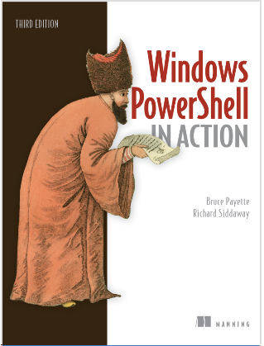
If you want to know more

